Slide 1

Linux Fundamentals
Trishant Maharjan

Slide 2
Operating System
Collection of software that manages a computer's hardware and applications by allocating resources, including memory, CPU, input/output devices and file storage.

Slide 3
Linux operating system
Linux is based on the UNIX operating system. UNIX is a powerful, multi-user, multitasking operating system originally developed in the 1970s at AT&T Bell Labs. It laid the foundation for many modern operating systems, including Linux.
Linux is free and open-source, accessible to everyone.
This promotes global collaboration and innovation.
Linux offers efficient performance and strong security.
It works well across many devices and industries.

Slide 4
Linux distributions
A Linux distribution is an operating system built on the Linux kernel, bundled with essential software, tools, and package managers, customized to serve different users like developers, enterprises, cybersecurity professionals, and general users.
Includes the Linux kernel, system tools, package manager, and optional desktop environment.
Comes with pre-installed tools, reducing manual setup.
Built for different purposes like hacking, servers, development, or desktop use.
Offers flexibility and customization based on user needs.

Slide 5
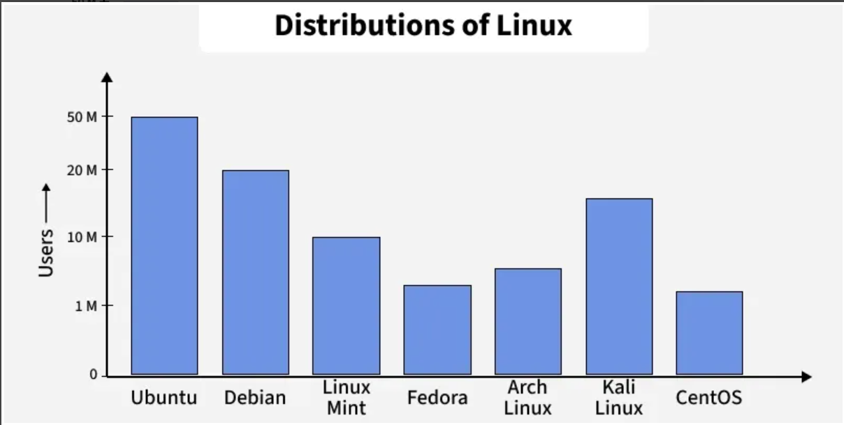
Source: Linux Distributions - GeeksforGeeks

Slide 6
Comparison of Linux / Windows Operating systems
S. No | Linux | Windows
1. | Linux is an open-source operating system. | Windows is not an open-source operating system.
2. | Linux is free of cost. | Windows is paid and requires a license.
3. | File names are case-sensitive, meaning file.txt and File.txt are different. | File names are case-insensitive, meaning file.txt and File.txt are treated the same.
4. | Uses a monolithic kernel. | Uses a hybrid kernel.
5. | More efficient and stable, especially for servers and developers. | Less efficient due to resource-intensive processes.
6. | Uses forward slash (/) for directory separation. | Uses backslash (\) for directory separation.
7. | More secure with better user control and fewer vulnerabilities. | Less secure due to higher susceptibility to malware and viruses.
8. | Preferred by hackers and security experts due to its open-source nature and control. | Not widely used for hacking as it lacks built-in security tools.
9. | Has 3 types of user accounts: (1) Regular, (2) Root, (3) Service Account. | Has 4 types of user accounts: (1) Administrator, (2) Standard, (3) Child, (4) Guest.
10. | Root user has all administrative privileges. | Administrator user has all administrative privileges.
11. | In Linux, you can have two files with the same name but different cases (File.txt and file.txt). | In Windows, you cannot have two files with the same name in the same folder.

Slide 7
Install linux os
Rocky Linux
Alma Linux
Ubuntu Linux

Slide 8
Operating System Concepts
I/O Management
File System
Users and Groups
File Permission and ownership
Memory / Storage
Processes
POSIX Standard
Systems and Services

Slide 9
I/O Management
Input/Output (IO) management is a crucial component of any operating system (OS). It encompasses the techniques and mechanisms an OS uses to manage the input and output operations of the computer system, ensuring efficient and effective communication between hardware and software components.

Slide 10
Principles of I/o management
IO devices, such as keyboards, storage devices, interact with the computer through device controllers. These controllers act as intermediaries, converting signals from the devices into a format the computer can understand and vice versa.
IO operations can be categorized into three main types:
Character IO: Involves reading and writing one character at a time (e.g., keyboards).
Block IO: Involves reading and writing large blocks of data (e.g., disk drives).
Network IO: Involves data transfer over a network.
Buffering is a technique where data is temporarily stored in a buffer while being transferred between two locations.

Slide 11
Principles of I/o management
Caching involves storing copies of data in a high-speed storage (cache) to reduce access time.
Spooling (Simultaneous Peripheral Operations On-Line) is a method where data is temporarily held in a buffer (spool) until the device is ready to process it.
Device drivers are specialized software modules that enable the OS to communicate with hardware devices.
DMA allows certain hardware subsystems to access main system memory independently of the CPU. This enhances performance by offloading IO operations from the CPU.

Slide 12
File system
Install tree in linux: sudo dnf install tree
Try "cd / && tree" and "cd / && tree –L 1 /"
Directories
/bin - Directory that contains binaries.
/boot - Directory that contains files to start your system. Do not touch.
/dev - Directory that contains device files (Virtual directory).
/etc - Directory that contains most, if not all, system-wide configuration files.
/home - Directory that contains users' personal directories.
/lib - Directory that contains libraries, dependencies used by binaries
/media - Directory where external storage are mounted automatically.

Slide 13
File system
/media - Directory where external storage are mounted automatically.
/mnt - Directory where you manually mount storage devices. Not used often.
/opt - Directory that contains software compiled by user. Binaries in /opt/bin and libraries in /opt/lib.
/proc - Directory that contains information such as CPU and the kernel used (Virtual directory).
/root - Home directory of superuser.
/run - Directory used by system processes to store temporary data.
/sbin - Directory containing binaries used by superuser, therefore (s)bin
/usr - Previously user directory, now binaries in other path are liked to /usr/bin, or /usr/local/bin.
/srv - Directory that contains data of web servers.
/sys - Contains information of devices connected to PC. Do not touch.(Virtual directory).
/tmp - Contains temporary files.
/var - Contains mostly logs or state information and persistent data for running applications.

Slide 14
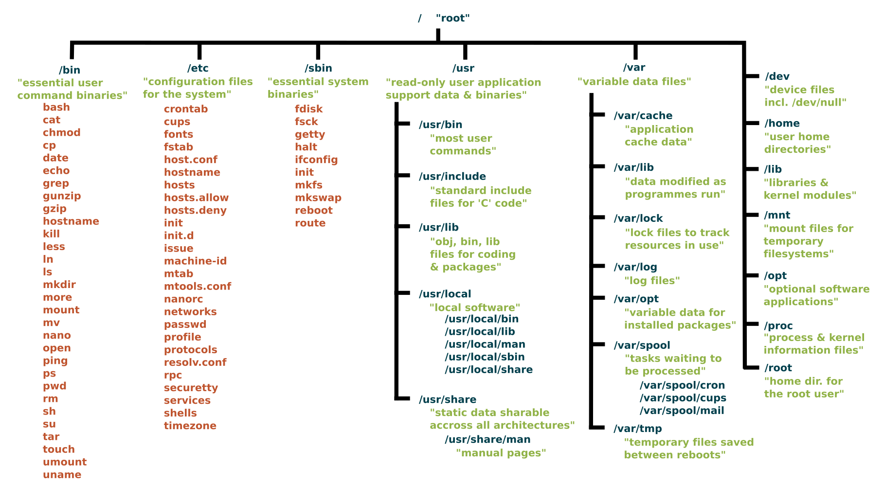
File system https://www.linuxfoundation.org/blog/blog/classic-sysadmin-the-linux-filesystem-explained

Slide 15
Users and groups
Users and Groups – Used to control access to files and resources.
Permissions - Rules to determine who can read, write, or execute files or directories.

Slide 16
Main and secondary groups
Primary/Main group – Default group a user gets when their account is created.
Secondary group - Secondary groups a user can join, up to 15 in total.
When a user is created, a group with same name is created automatically.
$ sudo useradd –create-home user-test
$ grep user-test /etc/passwd

Slide 17
Managing group members
To add user to a group/s:
$ sudo gpasswd -a username groupname or $ sudo usermod -aG groupname1, groupname2, .. username
To remove a user from a group:
$ sudo gpasswd -d username groupname
To create a new group:
$ sudo groupadd groupname
To change a user's primary group:
$ sudo usermod -g newgroup username

Slide 18
Deleting users and groups
To remove a user from a group.
sudo gpasswd -d username group_name
To delete a group:
sudo groupdel group_name
To delete a user:
sudo userdel username
To delete a user and their home folder:
sudo userdel -r username

Slide 19
File permissions and ownership
Set of permissions:
Owner: Person who created the file.
Group: Users in the file's assigned group.
Others: Everyone else in the system
Each user category has 3 possible permissions:
Read (r): See file contents or see in folder.
Write (w): Change file contents or add/remove files in a folder.
Execute (e): Run a file as a program or open a folder
Read | Write | Execute | Read | Write | Execute | Read | Write | Execute
0 | 1 | 1 | 1 | 0 | 0 | 1 | 0 | 0
Owner |  |  | Group |  |  | Others

Slide 20
Chown and chgrp
Change user and group ownership:
chown new_owner:new_group filename
Change group:
chgrp new_group filename

Slide 21
Special permission types
Set User ID (SUID):
Allows a program to run with the permissions of the file's owner, rather than the permissions of the user executing the file.
chmod 4755 file # SUID
Set Group ID (SGID):
Allows a program to run with the permissions of the file's group.
chmod 2755 file # SGID
Sticky Bit:
Prevents users from deleting or renaming files within a shared directory unless they are the owner of the file, the owner of the directory, or the root user.
chmod 1755 directory # Sticky Bit

Slide 22
Memory and storage
Memory | Storage
Memory is an electronic component that can store data and information on a temporary basis. | Storage refers to physical storage devices.
It is temporary data storage. | Data is stored both temporarily and permanently.
Memory is faster than storage. | Storage is slower than memory.
Memory can access data and information instantly. | Storage cannot access or modify data as fast as the memory.
It is a collection of computer chips installed in memory modules. | It is a technology consisting of core components of a computer.
When the computer loses the power, Data is lost . | No data is lost.
The memory module are expensive than storage. | Storage devices are cheaper.
Their size are not much larger and goes upto GBs. | Their size are much larger than memory and goes upto TBs.
It is used when data is stored for short time. | It is used when data is stored for long term.

Slide 23
Processes
In Linux, a process is any active (running) instance of a program. A program is any executable file held in storage on your machine. Anytime you run a program, you have created a process.
Whenever a command is issued in Unix/Linux, it creates/starts a new process. For example, pwd when issued which is used to list the current directory location the user is in, a process starts.
Through a 5 digit ID number Unix/Linux keeps an account of the processes, this number is called process ID or PID. Each process in the system has a unique PID.
Used up pid’s can be used in again for a newer process since all the possible combinations are used.
At any point of time, no two processes with the same pid exist in the system because it is the pid that Unix uses to track each process.

Slide 24
Foreground Process
Every process when started runs in foreground by default, receives input from the keyboard, and sends output to the screen.
When a command or process runs in the foreground, it occupies the terminal until it finishes executing.
This means no other commands or processes can be started during that time.
The terminal prompt becomes available only after the current process completes.
Eg: tail -f <log file name>

Slide 25
Background processes
It runs independently of the terminal, allowing you to perform other tasks simultaneously.
They do not require keyboard input while running.
To start a process in the background, add & at the end of the command.
Eg: sudo dnf update –y &

Slide 26
Processes
Tracking a process:
ps
Flags that can be used:
-a: Shows information about all users
-x: Shows information about processes without terminals
-u: Shows additional information like -f option
-e: Displays extended information
top
Killing a process:
kill <process id> or kill –9 <process id>

Slide 27
Posix Standard
POSIX stands for Portable Operating System Interface.
Defines a set of standard operating system interfaces based on the UNIX OS. These standards are specified by the IEEE (Institute of Electrical and Electronics Engineers) society which maintains the compatibility between different operating systems.
POSIX systems are theorized in such a way that data or code can be transferred seamlessly between any two systems that are POSIX compliant
POSIX standards define application programming interfaces (API) at both the system and user levels and command-line shells and utility interfaces for software compatibility and/or portability with various distributions of the Unix Operating System and other operating systems as well.
Developers are encouraged to use POSIX as it saves time for developers all around the world along with providing easier means for portability.

Slide 28
Systems and services
Linux services are background processes that start during boot and keep running to provide various functionalities.
Systemd is a modern system and service manager for Linux that serves as the core initialization process (PID 1). It controls system startup, manages background services, and ensures efficient system operation.
Starts automatically as the first process when the Linux kernel boots.
Manages all other processes during system runtime.
Uses parallelization to launch multiple services simultaneously, speeding up boot time.
Organizes system components into “units” such as services, sockets, devices, mounts, and timers.
Controlled via the systemctl command-line tool (start, stop, enable, disable, and check services).

Slide 29
Systemd
Start service: systemctl start <service name>
Stop service: systemctl stop <service name>
Enable service: systemctl enable <service name> (start service automatically on boot)
Disable service: systemctl disable <service name> (disable starting service automatically on boot)
Restart service: systemctl restart <service name>
Reload service: systemctl reload <service name>
Mask service: systemctl mask <service name> (Prevents the service from being started manually or automatically, even if required by other services)
Unmask service: systemctl unmask <service name> (Allows the service to be started or enabled again.)
Check status of service: systemctl status <service name>

Slide 30
Linux Shell
A shell is a special user program that provides an interface for the user to use operating system services.
Shell accepts human-readable commands from users and converts them into something which the kernel can understand.
It is a command language interpreter that executes commands read from input devices such as keyboards or from files.
The shell gets started when the user logs in or starts the terminal.
A terminal window typically consists of a command prompt, which is where you enter commands, and a text area where the output of those commands is displayed.

Slide 31
Bash vs shell
bash | sh
Bourne Again SHell | SHell
Developed by Brain Fox | Developed by Stephen R. Bourne
Successor of sh | Predecessor of bash
Bash is the default SHELL | Sh is the not default SHELL
#!/bin/bash | #!/bin/sh
It has more Functionality with up-gradation. | It has less functionality.
Supports job controls. | Does not support job control.
Bash is not a valid POSIX shell. | Sh is a valid POSIX shell.
Easy to use | Not as easy as bash
Less portable than sh. | More portable than bash.
Extended version of language | Original language
Supports command history. | Does not support command history.

Slide 32
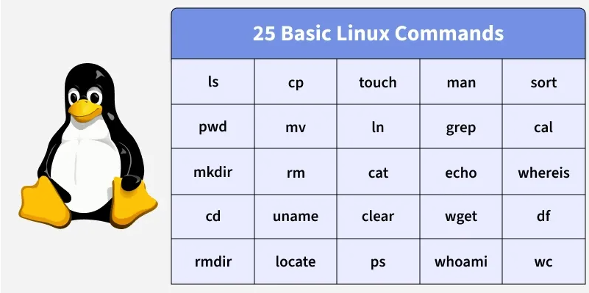
Basic linux commands
Source: https://www.geeksforgeeks.org/linux-unix/basic-linux-commands/

Slide 33
Text editor (vi)
Edit/Create a file
Vi <filename>
Press "i" to enter insert mode and esc to go back to normal mode
Use "$" to go to the end of the line and "0" to go to the beginning in normal mode
Use ":<line number>" to go to a particular line in normal mode
Use "x" to delete a character before the cursor in normal mode
Use "dd" to delete an entire line in normal mode
Use "D" to delete from the cursor position to the end of the line in normal mode
Use "yy" to copy a line in normal mode
Use "p" to paste below cursor position in normal mode or "P" to paste above cursor position in normal mode
Use ":w" to save, ":w filename" to save to a new file, ":wq" to write and quit vi, ":q" to quit vi, and ":q!" to quit without saving
Use "/string" to search, "Enter" to find next occurrence and "n" to go to repeat the search
Use "u" to undo the changes and "Ctrl + r" to redo
Use ":%s/foo/bar/g" to find and replace throughout the file

Slide 34
manpages
The "man" command, short for manual, is a powerful tool in the Linux operating system that allows users to access detailed information about various commands, utilities, and system calls.
The "man" command provides comprehensive documentation, helping users understand how to use and configure different elements of the Linux environment.
Commands:
Man <command>
Check Sections:
Man –f <command>
View all sections:
Man –a <command>
View particular section:
Man <number> <command>
Search for keywords:
Man –k <keyword>

Slide 35
Environment variables
Environment variables, often referred to as ENVs, are dynamic values that wield significant influence over the behavior of programs and processes in the Linux operating system.
These variables serve as a means to convey essential information to software and shape how they interact with the environment.
Every Linux process is associated with a set of environment variables, which guide its behavior and interactions with other processes.

Slide 36
Types of Environment variables
Global environment variables, when defined in a terminal, enjoys accessibility from anywhere within that terminal's environment. This means it can be employed by scripts, programs, or processes running within the scope of that terminal.
Local environment variables are confined to the specific terminal in which they are defined. They are isolated from external programs or processes, making their reach exclusive to the terminal that birthed them.

Slide 37
Shell Scripts - Basics of Bash Scripting
Shells are interactive, meaning they take user input and execute commands. But typing multiple commands repeatedly is inefficient.
Instead, you can store commands in a file a shell script and run them when needed. These scripts have .sh extension.
A shell script includes:
#!/bin/bash -> shebang, what to use as command interpreter
Shell Keywords: if, else, break, etc.
Shell Commands: cd, ls, echo, pwd, touch, etc.
Functions
Control Flow: if..then..else, case, loops, etc.
Below are some of the shebangs used for different purposes in shell scripts:
#!/bin/sh: It is used to execute the file using sh, which is a Bourne shell, or a compatible shell
#!/bin/csh: It is used to execute the file using csh, the C shell, or a compatible shell.
#!/usr/bin/perl -T: It is used to execute using Perl with the option for taint checks.
#!/usr/bin/php: It is used to execute the file using the PHP command-line interpreter.
#!/usr/bin/python -O: It is used to execute using Python with optimizations to code.
#!/usr/bin/ruby: It is used to execute using Ruby.

Slide 38
Terminal multiplexing
A terminal multiplexer is a software application that can be used to multiplex several separate pseudoterminal-based login sessions inside a single terminal display, terminal emulator window, PC/workstation system console, or remote login session, or to detach and reattach sessions from a terminal.

Slide 39
Package management
A package manager is a command-line or graphical tool used to automate the process of installing, updating, and removing software packages on a Linux system.
Software packages are collections of files, including executables, libraries, configuration files, and documentation, that are bundled together for easy distribution and installation.
Package managers keep track of these packages, making it easier to manage software on a Linux system.

Slide 40
Functionalities of package manager
Installation: Package managers facilitate the installation of software packages from repositories or local files. They automatically handle dependencies, ensuring that all required components are installed.
Dependency Resolution: Linux software often relies on other packages. Package managers detect these dependencies and fetch and install them automatically.
Upgrading: Package managers allow users to update installed software to the latest versions. This helps in keeping the system secure and up-to-date.
Removal: Uninstalling software is straightforward with package managers. They ensure that all related files and dependencies are removed, preventing conflicts.
Querying: Users can query the package manager to get information about installed packages, available updates, and package details.

Slide 41
Package manager commands (dnf and rpm)
Installing a package
Sudo dnf install <package name>
Sudo rpm –ivh or –Uvh <package name>
Upgrading packages
Sudo dnf update
Removing package
Sudo dnf remove <package name>
Sude rpm –e <package name>
List installed packages
rpm –qa

Slide 42
Scheduling Scripts / Tasks
The crontab command in Linux is used to create, edit, and manage scheduled tasks (cron jobs) that run automatically at specified times or intervals.
It allows users to automate repetitive system and administrative tasks without manual intervention.
Check if service is running: systemctl status crond
Syntax of crontab: min hr day month weekday command , for cron schedule expression https://crontab.guru/
View crontab entries: crontab –l
View crontab entries of other users (as root): crontab –u <username> -l
Edit crontab entries: crontab –e
Remove crontab entries: crontab -r

Slide 43
Crontab – special strings
@reboot: Run once after system startup.
@yearly or @annually: Run once a year.
@monthly: Run once a month (first day, 00:00).
@weekly: Run once a week.
@daily or @midnight: Run once a day (00:00).
@hourly: Run once an hour (at the beginning of the hour).

Slide 44
Daemons
Processes that starts and boot and never stops or finishes.
Are services.
A daemon is a process that:
Has no controlling terminal — can’t read from stdin, can’t write to stdout/stderr
Is detached from user sessions — keeps running even when users log out
Is typically started at boot — launched by the init system
Runs in the background — no direct user interaction
Performs system services — handles requests or scheduled tasks

Slide 45
SSH
It is a transport layer that is used for secure logins and share of information between two secured endpoints.
It secures the exchange through public and private keys.
Used for secure communications between an organization and a remote server.
Example: ssh –p <port> -i <path to private key> username@remote_host_address

Slide 46
SFTP
It is a protocol build over SSH to efficiently transfer files in a secured way.
With the use of this protocol, it can easily move large amounts of data securely over an internet connection.
It utilizes the SSH and makes the information exchange with a higher level of protection.
Example: sftp root@192.168.56.2:/home/SGID-test.log . (To get file from server to PC)
Run sftp <user>@<ip>
Change directory using cd
Run get <file name> or put <file name>
Exit using ctrl + c

Slide 47
SCP
SCP (Secure Copy Protocol) allows users to securely transfer files between systems.
As it uses SSH, all transferred data is encrypted, making it a safe choice for transmitting sensitive files.
Send file to server:
scp file.txt username@192.168.1.2:/home/username/
Get file from server:
scp username@192.168.1.2:/home/username/file.txt .
User flag –r to copy directories

Slide 48
rsync
rsync or remote synchronization is a software utility for Unix-Like systems that efficiently sync files and directories between two hosts or machines. One is the source or the local-host from which the files will be synced, the other is the remote-host, on which synchronization will take place. There are basically two ways in which rsync can copy/sync data:
Copying/syncing to/from another host over any remote shell like ssh, rsh.
Copying/Syncing through rsync daemon using TCP.
Install rsync: dnf install rsync –y (needed in both source and destination)
Sync to server: rsync local-file user@remote-host:remote-file
Sync directory locally: rsync -avh foo/ bar/
Sync ignoring existing files: rsync --ignore-existing -avhe /foo user@remote-host:/tmp/
Sync directory:
rsync -avz /source_dir/ user@remote_host:/remote_dir/ (Push)
rsync -avz user@remote_host:/remote_dir/ /local_dir/ (Pull)

Slide 49
Archiving - tar
The tar command in Linux, short for Tape Archive, is a powerful and widely used tool for creating, viewing, and extracting files from archives.
The tar command bundles multiple files into a single archive file, optionally compressing them using options like -z (gzip) or -j (bzip2), but they don't change the directory structures, which makes it ideal for backups or file distribution.
Creating an uncompressed tar archive
tar -cvf file.tar * or <directory>
'-c': Creates a new archive.
'-v': Displays verbose output, showing the progress of the archiving process.
'-f': Specifies the filename of the archive
Extract from archive: tar –xvf file.tar

Slide 50
Archiving - gzip
The gzip command in Linux is used to compress files efficiently, reducing their size to save storage space and speed up file transfer without losing data.
Uses the Lempel-Ziv (LZ77) compression algorithm for speed and efficiency.
Replaces the original file with a compressed version ending in .gz.
Can decompress files using the -d option or the gunzip command.
Compress a file: gzip <filename> or <filename 1> <filename 2> … <filename n>
Decompress a gzip file: gzip –d <filename>.gz
Compress while keeping the file: gzip –k <filename>

